Slide 1

MNIST Digits Prediction using Dense Neural Network

Slide 2
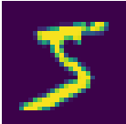

The Neural Network Layout
512
512
784

Slide 3
Sigmoid, ReLu, and Dropout
Sigmoid ReLu
Dropout Layer

Slide 4
Gradient, Forward Pass, Back-Prop, Cross-Entropy
Gradient
Forward Propagation
Dropout Layer
Backpropagation
Cross-Entropy

Slide 5
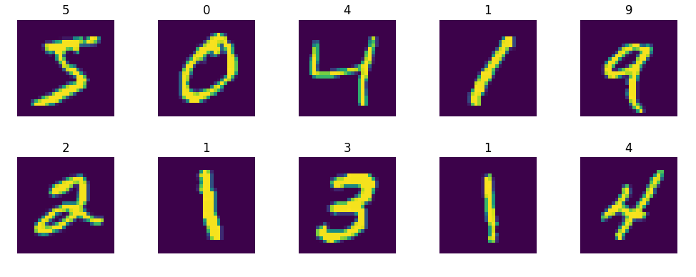
MNIST Digits

Slide 6
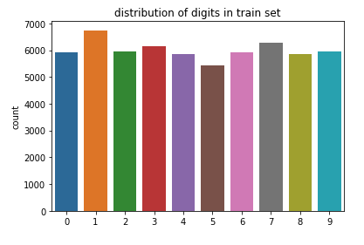
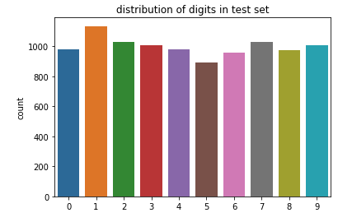
Distribution of data

Slide 7
The Neural Network Model

Slide 8
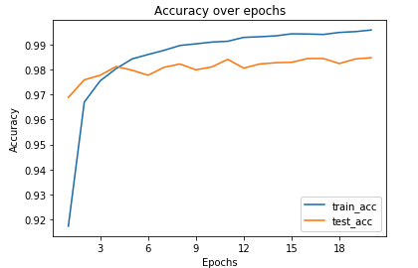
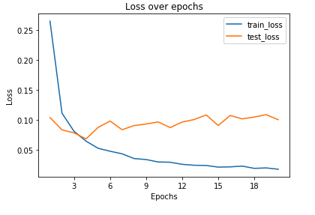
Accuracy and Loss over Epochs

Slide 9
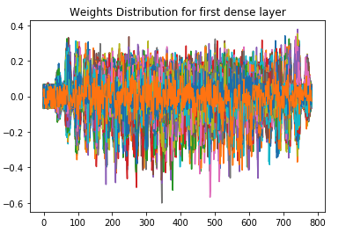
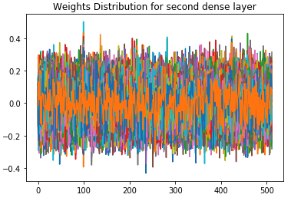
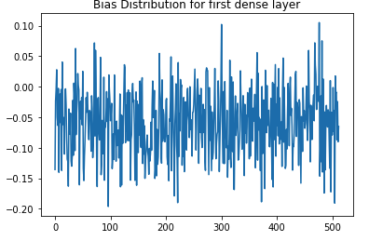
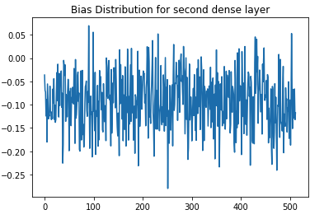
Glorot normal initializer (Xavier normal initializer)
It draws samples from a truncated normal distribution centered on 0 with stddev = sqrt(2 / (fan_in + fan_out)) where fan_in is the number of input units in the weight tensor and fan_out is the number of output units in the weight tensor.
In short, it helps signals reach deep into the network.
If the weights in a network start too small, then the signal shrinks as it passes through each layer until it’s too tiny to be useful.
If the weights in a network start too large, then the signal grows as it passes through each layer until it’s too massive to be useful.
Xavier initialization makes sure the weights are ‘just right’, keeping the signal in a reasonable range of values through many layers.

